Slide 1

Major Project Synopsis
On
Air pollution level detection in all over the world using Machine Learning
In partial fulfilment requirement of the degree Of
Bachelor of Technology
In
Computer Science and Engineering
Submitted By:
Harsh Chourasiya (20100BTCSDSI07273)
Under the guidance of
Prof. Om kant Sharma Sir
Department of Computer Science and Engineering
Shri Vaishnav Vidyapeeth Vishwavidyalaya
Jul-Dec-2022
Shri Vaishnav Institute of Information Technology

Slide 2

Air Pollution level
In All over World

Slide 3
Contain
Introduction
How our model works
Impact

Slide 4




Introduction
Air pollution is contamination of the indoor or outdoor environment by any chemical, physical or biological agent that modifies the natural characteristics of the atmosphere.
Household combustion devices, motor vehicles, industrial facilities and forest fires are common sources of air pollution. Pollutants of major public health concern include particulate matter, carbon monoxide, ozone, nitrogen dioxide and sulfur dioxide. Outdoor and indoor air pollution cause respiratory and other diseases and are important sources of morbidity and mortality.
WHO data show that almost all of the global population (99%) breathe air that exceeds WHO guideline limits and contains high levels of pollutants, with low- and middle-income countries suffering from the highest exposures.
Air quality is closely linked to the earth’s climate and ecosystems globally. Many of the drivers of air pollution (i.e. combustion of fossil fuels) are also sources of greenhouse gas emissions. Policies to reduce air pollution, therefore, offer a win-win strategy for both climate and health, lowering the burden of disease attributable to air pollution, as well as contributing to the near- and long-term mitigation of climate change.

Slide 5


IMPACT
From smog hanging over cities to smoke inside the home, air pollution poses a major threat to health and climate.
Ambient (outdoor) air pollution in both cities and rural areas is causing fine particulate matter which result in strokes, heart diseases, lung cancer, acute and chronic respiratory diseases.
Additionally, around 2.4 billion people are exposed to dangerous levels of household air pollution, while using polluting open fires or simple stoves for cooking fuelled by kerosene, biomass (wood, animal dung and crop waste) and coal.
The combined effects of ambient air pollution and household air pollution is associated with 7 million premature deaths annually.
Sources of air pollution are multiple and context specific. The major outdoor pollution sources include residential energy for cooking and heating, vehicles, power generation, agriculture/waste incineration, and industry. Policies and investments that support sustainable land use, cleaner household energy and transport, energy-efficient housing, power generation, industry, and better municipal waste management can effectively reduce key sources of ambient air pollution.

Slide 6
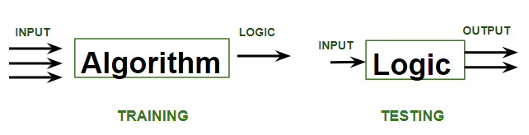
Working Model supervise ML

Slide 7
“ Supervised learning means that a model learns from previous examples and is trained on labeled data. In other words, the dataset has tags that tell the model which patterns are related to fraud and which represent normal behavior ”.
In supervised learning, models are trained using labelled dataset, where the model learns about each type of data. Once the training process is completed, the model is tested on the basis of test data (a subset of the training set), and then it predicts the output.

Slide 8
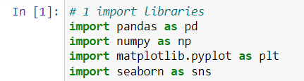
1. Importing the libraries

Slide 9

2. Reading the dataset

Slide 10
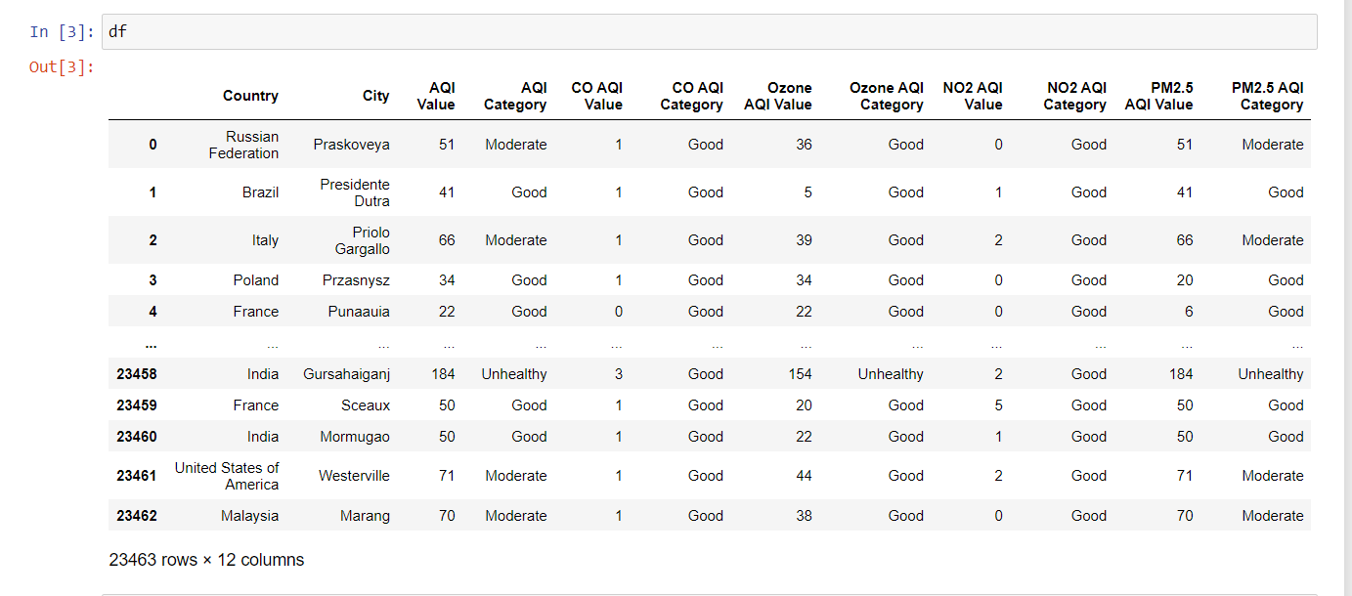
3. Data Analysis

Slide 11
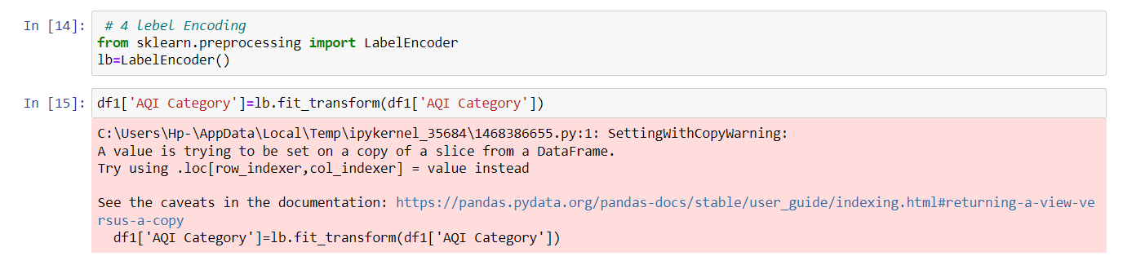
4. Label encoding

Slide 12
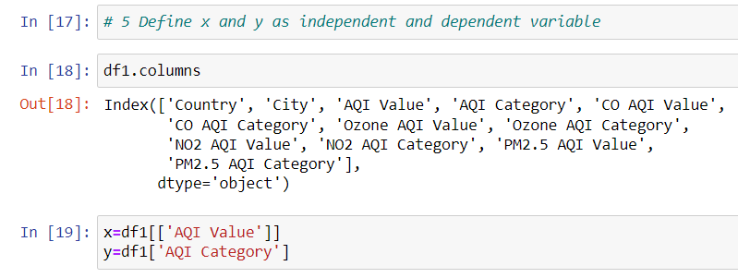
5. Defining independent and dependent variable

Slide 13
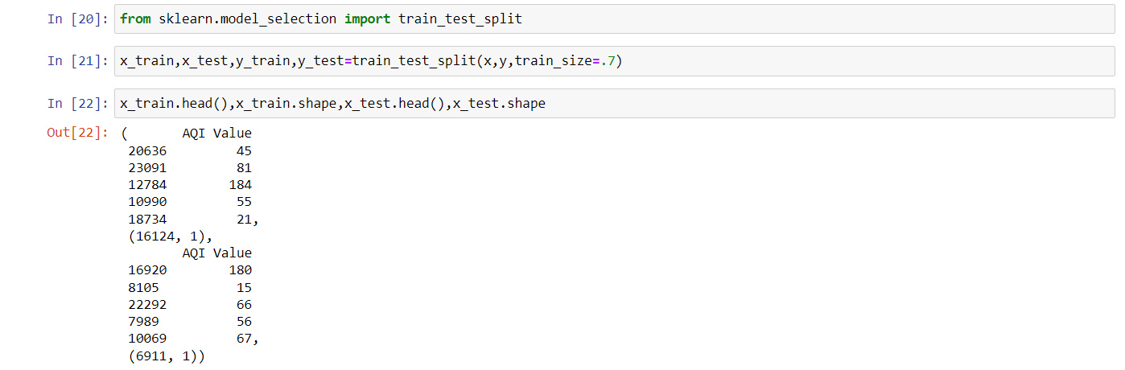
6. Split Data set

Slide 14
Logistic Regression

Slide 15
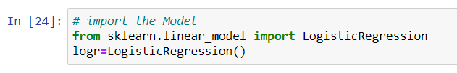
7. Import model

Slide 16
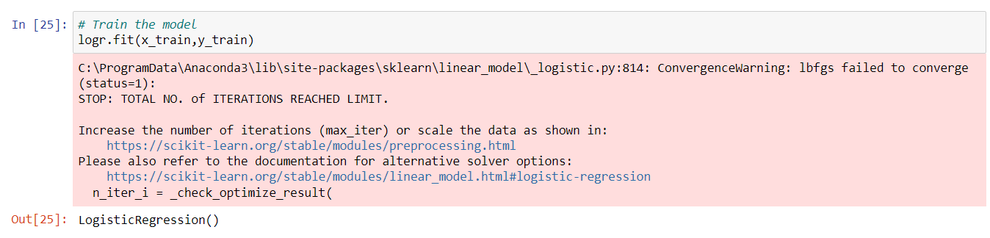
8. Train Model

Slide 17
9. Predection

Slide 18
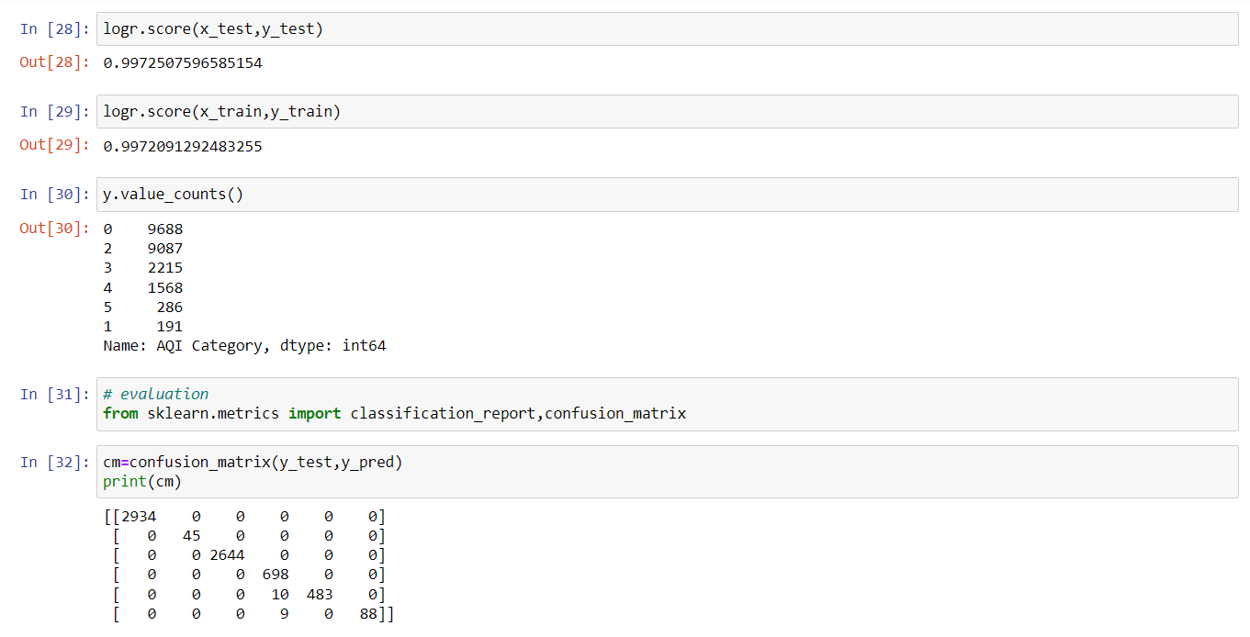
10. Evaluation

Slide 19
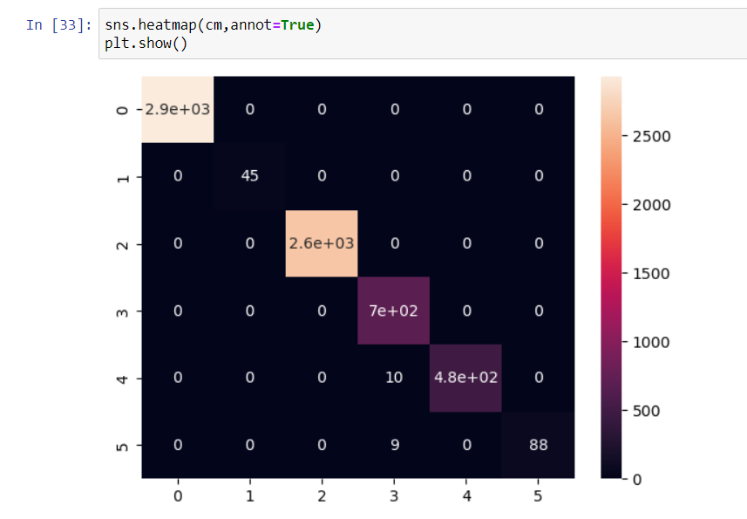
11. Visualization

Slide 20

Decision Tree Classifier

Slide 21
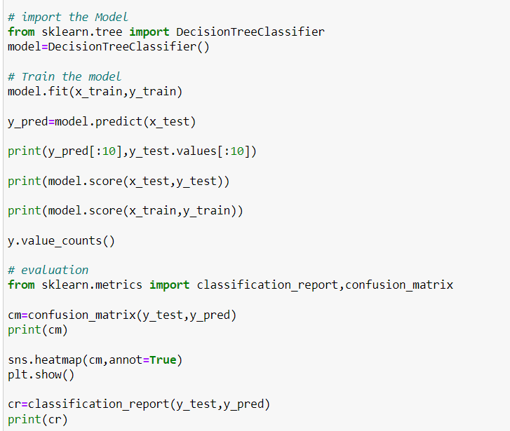

Slide 22
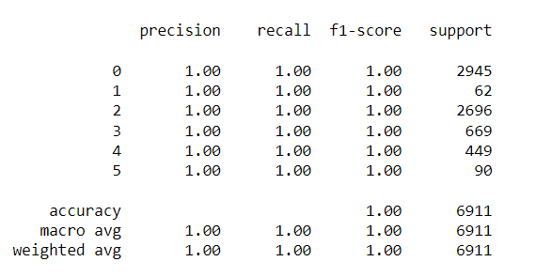
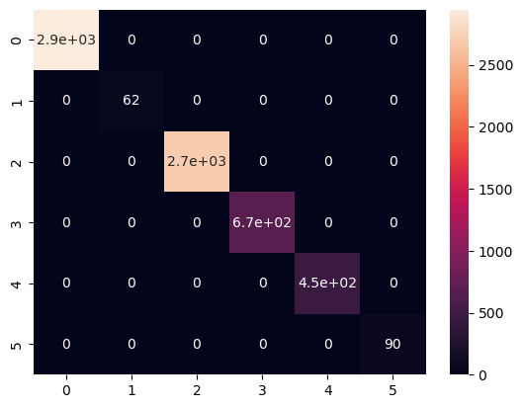
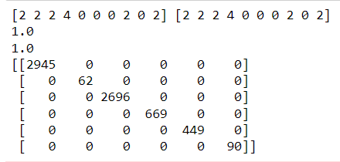

Slide 23

Linear Regression

Slide 24
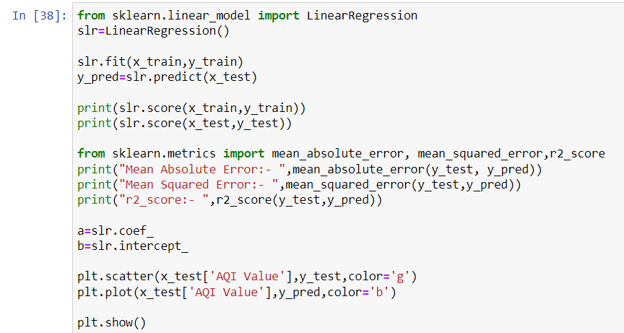

Slide 25
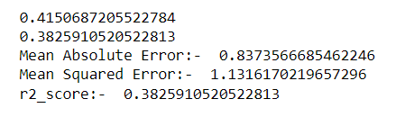
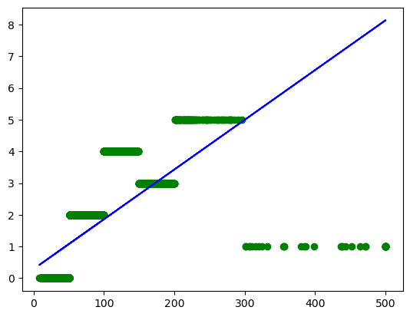

Slide 26

Decision Tree Regressor

Slide 27
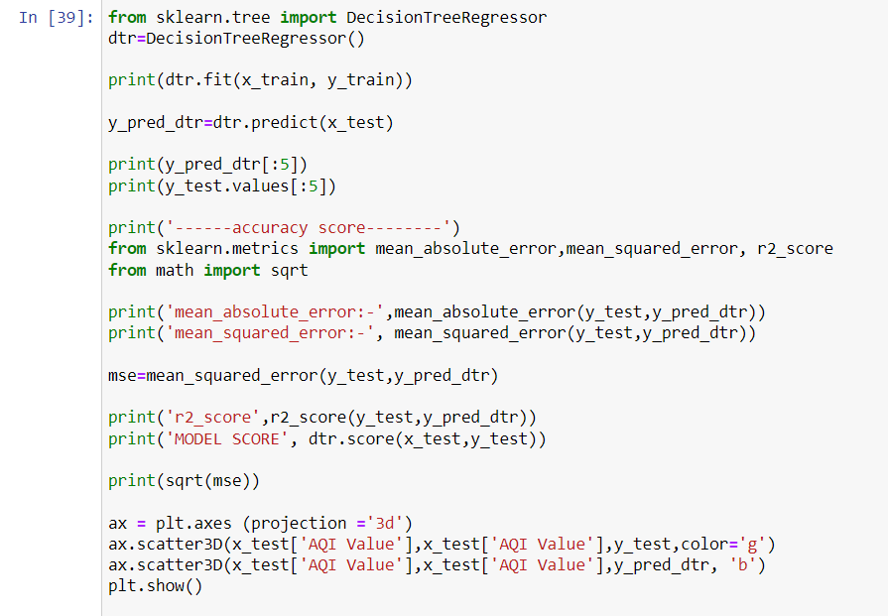

Slide 28
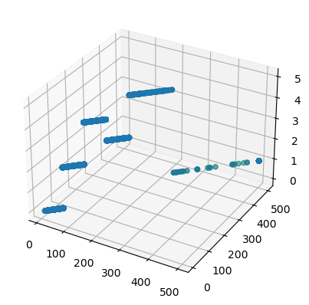
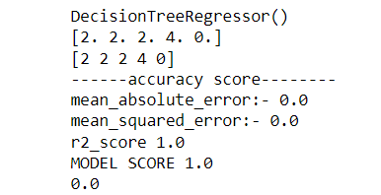

Slide 29

Thankyou

